Slide 1

Welcome

Slide 2

Welcome

Slide 3
Welcome

Slide 4
The REJECTED King
¹⁶ Finally Pilate handed him over to them to be crucified.
The Crucifixion of Jesus
So the soldiers took charge of Jesus. ¹⁷ Carrying his own cross, he went out to the place of the Skull (which in Aramaic is called Golgotha). ¹⁸ There they crucified him, and with him two others—one on each side and Jesus in the middle.
John 19:16–18 – NIV

Slide 5
The COMPASSIONATE King
25 Near the cross of Jesus stood his mother, his mother’s sister, Mary the wife of Clopas, and Mary Magdalene. 26 When Jesus saw his mother there, and the disciple whom he loved standing nearby, he said to her, “Woman,[a] here is your son,” 27 and to the disciple, “Here is your mother.” From that time on, this disciple took her into his home.
John 19:25-27

Slide 6
The COMPASSIONATE King
25 Near the cross of Jesus stood his mother, his mother’s sister, Mary the wife of Clopas, and Mary Magdalene. 26 When Jesus saw his mother there, and the disciple whom he loved standing nearby, he said to her, “Woman,[a] here is your son,” 27 and to the disciple, “Here is your mother.” From that time on, this disciple took her into his home.
John 19:25-27

Slide 8
The VICTORIOUS King
28 Later, knowing that everything had now been finished, and so that Scripture would be fulfilled, Jesus said, “I am thirsty.” 29 A jar of wine vinegar was there, so they soaked a sponge in it, put the sponge on a stalk of the hyssop plant, and lifted it to Jesus’ lips. 30 When he had received the drink, Jesus said, “It is finished.” With that, he bowed his head and gave up his spirit.
John 19:28–30

Slide 9
Sermon title

Slide 10


Slide 11
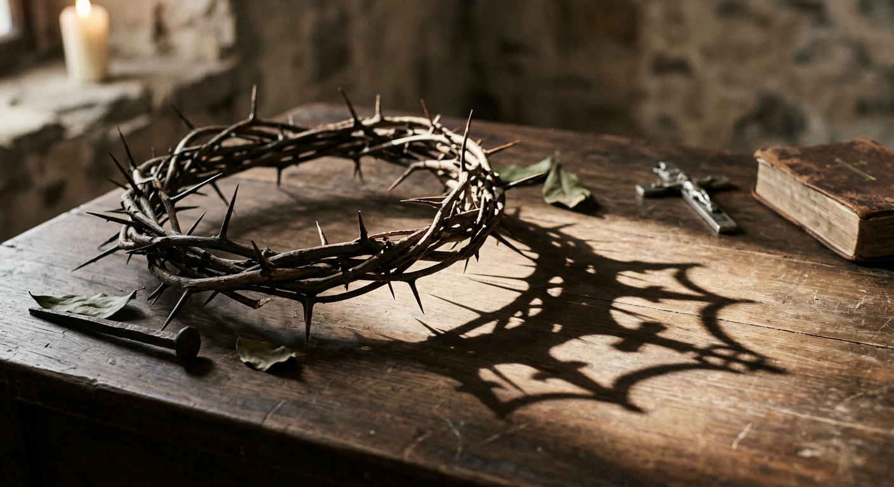

Slide 12


Slide 13
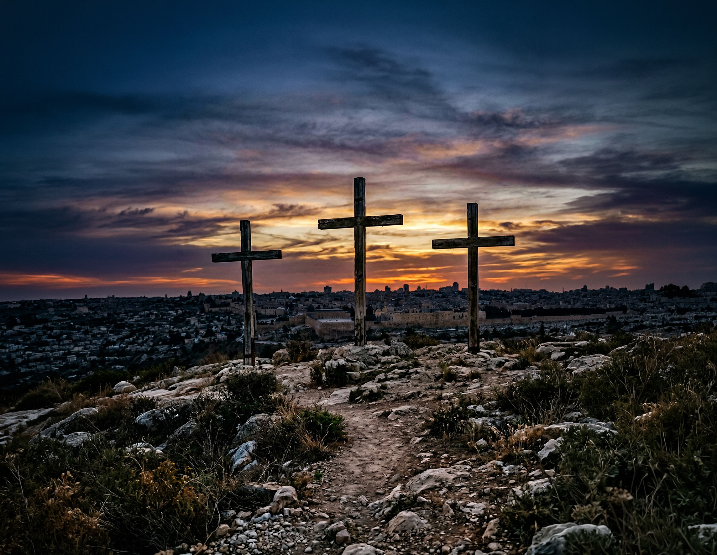

Slide 14


Slide 15
