Slide 1




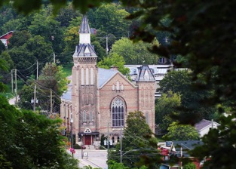
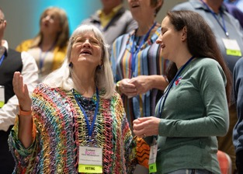

Slide 2
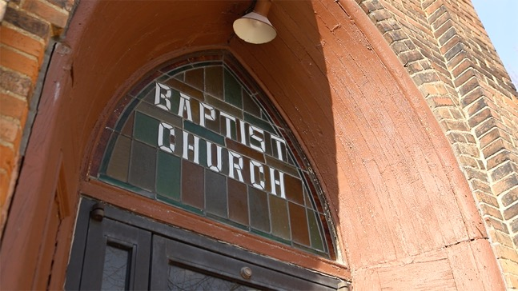
churches
CBOQ exists to equip churches
and leaders to engage with their mission from God in their community

Slide 3
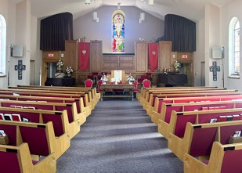
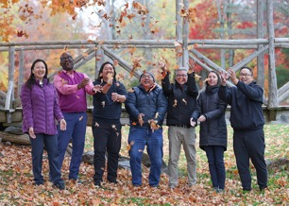
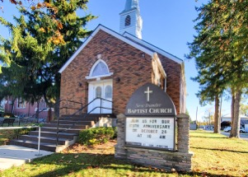
290
Churches
15
Associations
The CBOQ Board Of Directors & Staff Team
Supported By
Carver Model Of Governance
Guided By The

Slide 4
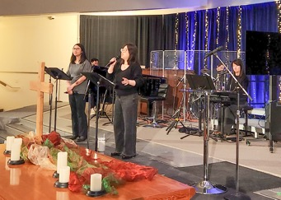
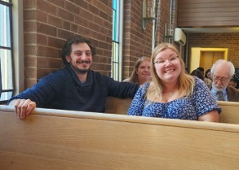
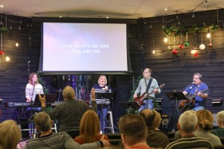
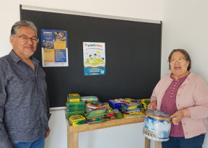
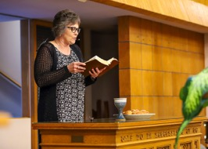
Our Churches Are...
Traditional and contemporary
Located in schools, sanctuaries,
community centres-even hockey arenas
Big, small, and everything in between

Slide 5
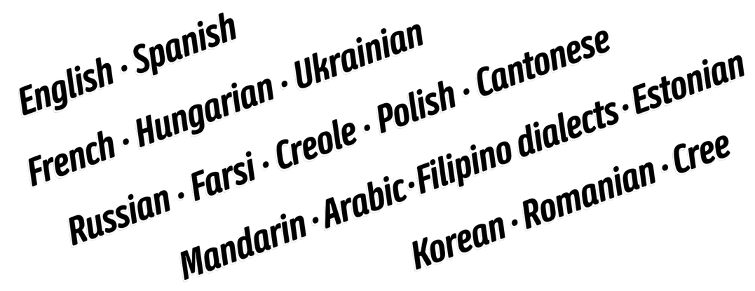
English, Creole
Cantonese
Ukrainian
Arabic
Hungarian
Russian
French
Cree
Spanish
Farsi
Filipino
Polish
Korean
Estonian
Mandarin
We Worship In Many Languages

Slide 6
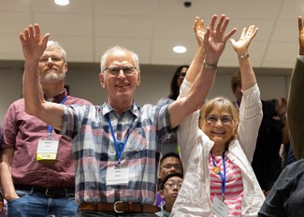
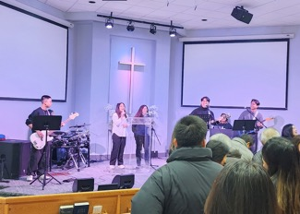
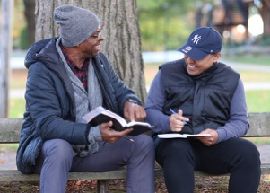
We Share In Common:
A love for God and commitment to Scripture
A heart for mission and service
Faithfulness to serve where
God places us
A covenantal relationship
with our CBOQ family
These are summarized by our Baptist distinctives.

Slide 7



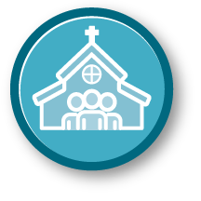



Baptist Distinctives
Jesus is Lord
The Word of God is the Authoritative Rule of Faith and Practice
The Priesthood of All Believers
A Believers’ Church
Mission and Evangelism
Church Autonomy and Association
Freedom and Equality
Jesus is Lord
The Word of God is the Authoritative Rule of Faith and Practice
The Priesthood of All Believers
A Believers’ Church
Freedom and Equality
Mission and Evangelism
Church Autonomy and Association

Slide 8
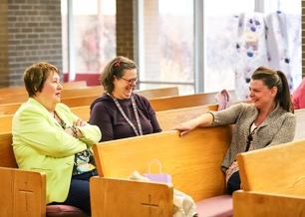

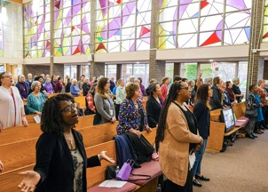
What Does CBOQ Do?
Support churches in their mission
and calling
Oversee credentialing and ordination
Provide resources
Help churches in crisis
Connect churches to one another
Offer meaningful ministries like youth retreats and leadership training

Slide 9
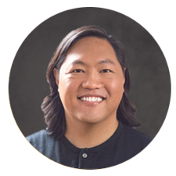
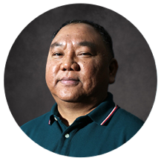
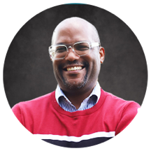
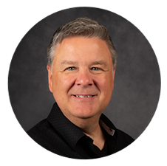
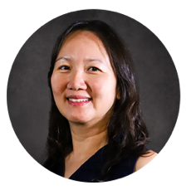
Meet Your Regional Associates
NELSON CHANG
Northwestern,
Northern,
Midwestern,
Georgian Bay,
Trent Valley
RUEBEN “RG”
FONCARDAS
Toronto
CID LATTY
Western,
Armba,
Midwestern,
Elgin,
Middlesex-Lambton-Huron
CARL WALTERS
Cbon (Norfolk),
Oxford-Brant,
Niagara-Hamilton,
South Central
KAREN WONG
Quebec,
Ottawa,
Former Canada Central

Slide 10

A Family of Churches
Transformed by Christ
Revealing God’s Kingdom

