Slide 1

Advent is a time to prepare our hearts for both the celebration of Jesus’ birth and the anticipation of His promised return. This year, our theme is “At the Manger,” where we invite you to journey back to the humble birthplace of our Savior. Amid the hustle and bustle of the Christmas season—filled with shopping, gatherings, and endless to-do lists—Advent offers us a sacred opportunity to pause and reflect on the profound mystery of God coming to dwell among us.

Slide 2
As we focus on the manger, we are reminded of the powerful simplicity of Christ’s arrival and the deep significance of His love, peace, hope, and joy. It’s a time to turn our hearts away from worldly distractions and instead, like the shepherds and wise men, come and adore the King who was born to save us all. This Advent, let us draw near to the manger and find our lives transformed by the presence of Christ.

Slide 3

Today, we begin the season of Advent. Advent is the time leading up to Christmas that we remember the waiting of those who longed for a Messiah, and make space for our own waiting in a world that longs for Christ’s return. Each week we light a candle as we journey to the manger together.
Today, we light the candle of hope. We remember, with hope, that God often reveals God’s self to us in unexpected ways. We hope in the Christ who came to us in a manger at Christmas, and hold onto hope that Christ is with us still.

Slide 4

Today, on this second Sunday of advent, we light the candle of peace. When the circumstances of our lives and our world seem beyond understanding, we trust in the Prince of Peace, who was born in a manger.

Slide 5

Today on this third Sunday of advent we light the candle of joy. Joy can often feel like an elusive feeling, even at Christmastime. The realities of our lives can make Christmas joy feel far away. But today we light this candle not because our lives are without sadness, but because Christ has come to bring joy to the world, a joy that is not contingent on circumstance, but found in the hope of eternity.

Slide 6

Today, on this fourth Sunday of advent, we light the candle of love. The story of the magi reminds us of God’s great plan to share His love with all people. We have all been invited into the story of God’s love.

Slide 7
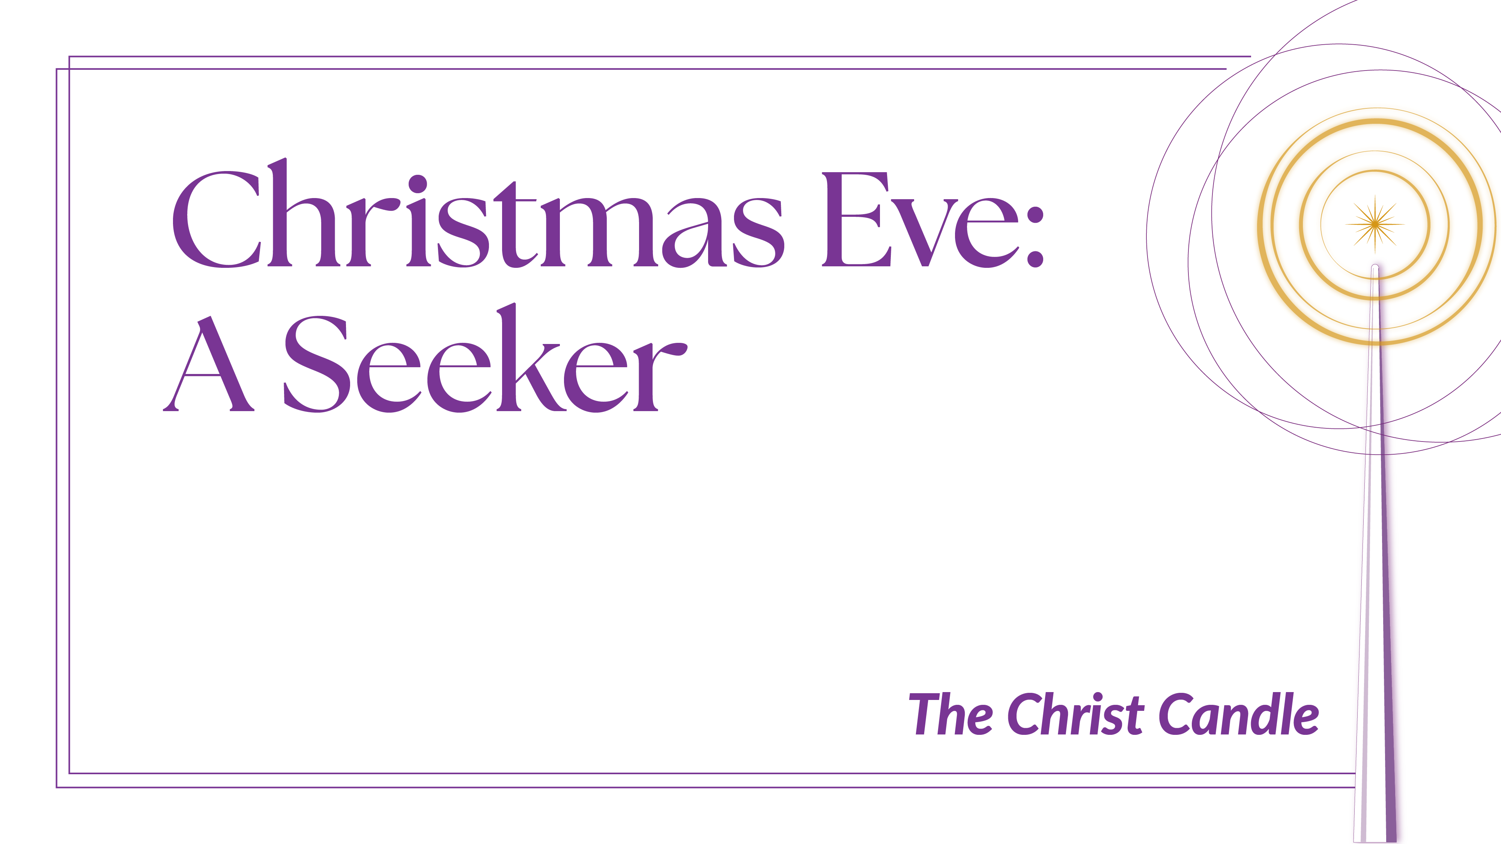
Tonight we light the final candle, the Christ candle, remembering the birth of Christ who was found At the Manger. As we light this candle, we do so with gratitude that Christ is with us in this Christmas season and always, and we await for the return of Christ in His glory.

Slide 8

Why Advent?
Today, on this fourth Sunday of advent, we light the candle of love. The story of the magi reminds us of God’s great plan to share His love with all people. We have all been invited into the story of God’s love.

Slide 9

Why Advent?
Today, on this fourth Sunday of advent, we light the candle of love. The story of the magi reminds us of God’s great plan to share His love with all people. We have all been invited into the story of God’s love.

Slide 10

Why Advent?
Today, on this fourth Sunday of advent, we light the candle of love. The story of the magi reminds us of God’s great plan to share His love with all people. We have all been invited into the story of God’s love.

