Slide 1
The Seven Last Words of Jesus

Slide 2
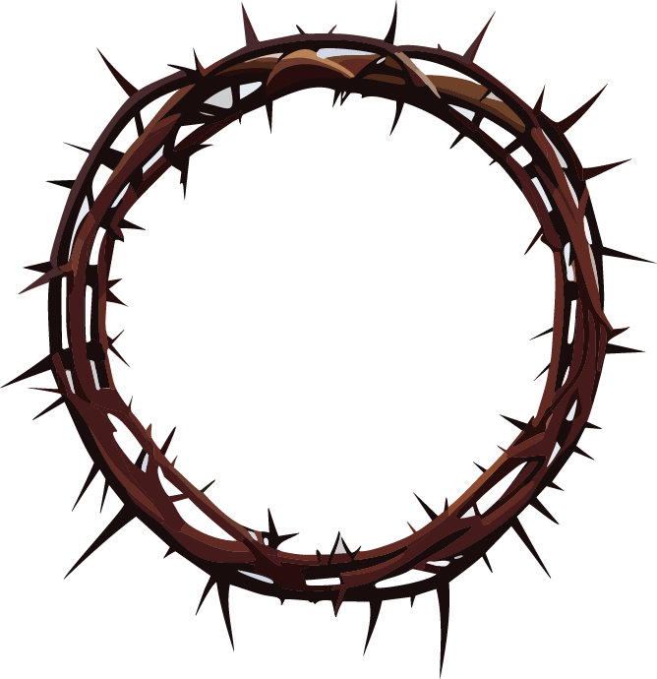
1
“Father, forgive them, for they do not know what they are doing.”

Slide 3
1
“Father, forgive them, for they do not know what they are doing.”
“When they came to the place called the Skull, they crucified him there, along with the criminals—one on his right, the other on his left. Jesus said, “Father, forgive them, for they do not know what they are doing.” And they divided up his clothes by casting lots.”
– Luke 23:33-34 (NIV)

Slide 4
1
REFLECTION
Take a moment to reflect on the forgiveness that Jesus extended even in the midst of His suffering.
Consider times when you have been forgiven and those moments when forgiveness is needed in your life.
Is there someone you need to forgive today?

Slide 5
1
PRAYER
Loving Father, grant us the grace to forgive as Jesus forgave. Help us release the burden of resentment and extend mercy to those who have wronged us.

Slide 6
2
“Today you will be
in paradise with me.”

Slide 7
2
“Today you will be in paradise with me.”
One of the criminals who hung there hurled insults at him: “Aren’t you the Messiah? Save yourself and us!”
But the other criminal rebuked him. “Don’t you fear God,” he said, “since you are under the same sentence? We are punished justly, for we are getting what our deeds deserve. But this man has done nothing wrong.”
(Continued)

Slide 8
2
“Today you will be in paradise with me.”
Then he said, “Jesus, remember me when you come into your kingdom.”
Jesus answered him, “Truly I tell you, today you will be with me in paradise.”
– Luke 23:39-43 (NIV)

Slide 9
2
REFLECTION
Take a moment to reflect on the amazing grace that Jesus extends.
Have you received this grace? Talk to Jesus, talk to a pastor or Christian friend/family member to know more.
Is there someone you know that needs to hear this message? Pray for them.

Slide 10
2
PRAYER
Gracious Lord, grant us the assurance of Your presence in our lives and the hope of eternal communion with You.

Slide 11
3
“Woman, here is your son. Here is your mother.”

Slide 12
3
“Woman, here is your son. Here is your mother.”
Near the cross of Jesus stood his mother, his mother’s sister, Mary the wife of Clopas, and Mary Magdalene. When Jesus saw his mother there, and the disciple whom he loved standing nearby, he said to her, “Woman, here is your son,” and to the disciple, “Here is your mother.” From that time on, this disciple took her into his home.
– John 19:25-27 (NIV)

Slide 13
3
REFLECTION
Jesus invites us into a relationship with Him - how has Jesus defined this relationship with you?
How are your relationships with others? Where can there be improvement?
How open is your church community to new relationships with newcomers, new adherents, new members? Where can there be improvement?

Slide 14
3
PRAYER
Lord Jesus, teach us to care for one another as You cared for Your mother and disciples. Help us build communities of love and support.

Slide 15
4
“My God, my God, why have you forsaken me?”

Slide 16
4
“My God, my God, why have you forsaken me?”
At noon, darkness came over the whole land until three in the afternoon. And at three in the afternoon Jesus cried out in a loud voice, “Eloi, Eloi, lema sabachthani?” (which means “My God, my God, why have you forsaken me?”).
– Mark 15:33-34 (NIV)

Slide 17
4
REFLECTION
Contemplate the depth of Jesus’ isolation and abandonment.
How would you gauge the distance you are experiencing with God? Is He near or far? Are you near or far?

Slide 18
4
PRAYER
Lord, in moments of despair, remind us of Your enduring presence and grant us the strength to trust in Your plan even when it is beyond our understanding.

Slide 19
5
“I am thirsty.”

Slide 20
5
“I am thirsty.”
Later, knowing that everything had now been finished, and so that Scripture would be fulfilled, Jesus said, “I am thirsty.”
– John 19:28 (NIV)

Slide 21
5
REFLECTION
Reflect on the spiritual longing and search for meaning in your own life.
What are the ways we try to quench thirst and meaning apart from Jesus?

Slide 22
5
PRAYER
Jesus, Living Water, quench our thirst for purpose and meaning. Help us find fulfillment in You alone.

Slide 23
6
“It is finished.”

Slide 24
6
“It is finished.”
A jar of wine vinegar was there, so they soaked a sponge in it, put the sponge on a stalk of the hyssop plant, and lifted it to Jesus’ lips. When he had received the drink, Jesus said, “It is finished.” With that, he bowed his head and gave up his spirit.
– John 19:29-30 (NIV)

Slide 25
6
REFLECTION
Meditate on the completion of Jesus' earthly mission and the accomplishment of salvation.
Consider the significance of redemption in your life.
Express gratitude to Christ for His finished work.

Slide 26
6
PRAYER
Merciful Saviour, thank you for completing the work of salvation. Help us live in the freedom and grace that Your sacrifice has provided.

Slide 27
7
“Father, into your hands I commit my spirit.”

Slide 28
7
“Father, into your hands I commit my spirit.”
Jesus called out with a loud voice, “Father, into your hands I commit my spirit.” When he had said this, he breathed his last.
– Luke 23:46

Slide 29
7
REFLECTION
Reflect on the surrender of Jesus' spirit into the hands of the Father.
Consider moments in your life where you need to surrender and trust in God's providence.
Express your gratitude to God for Christ’s atoning work.

Slide 30
7
PRAYER
Heavenly Father, we commend our lives into Your hands. Grant us the grace to surrender our will to Yours and trust in Your divine plan.

