Slide 1
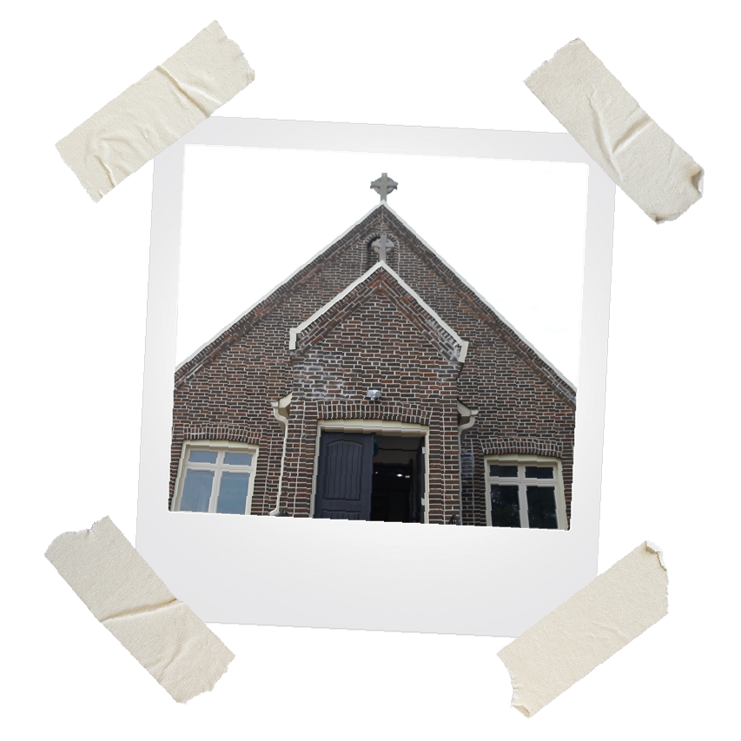



Slide 2
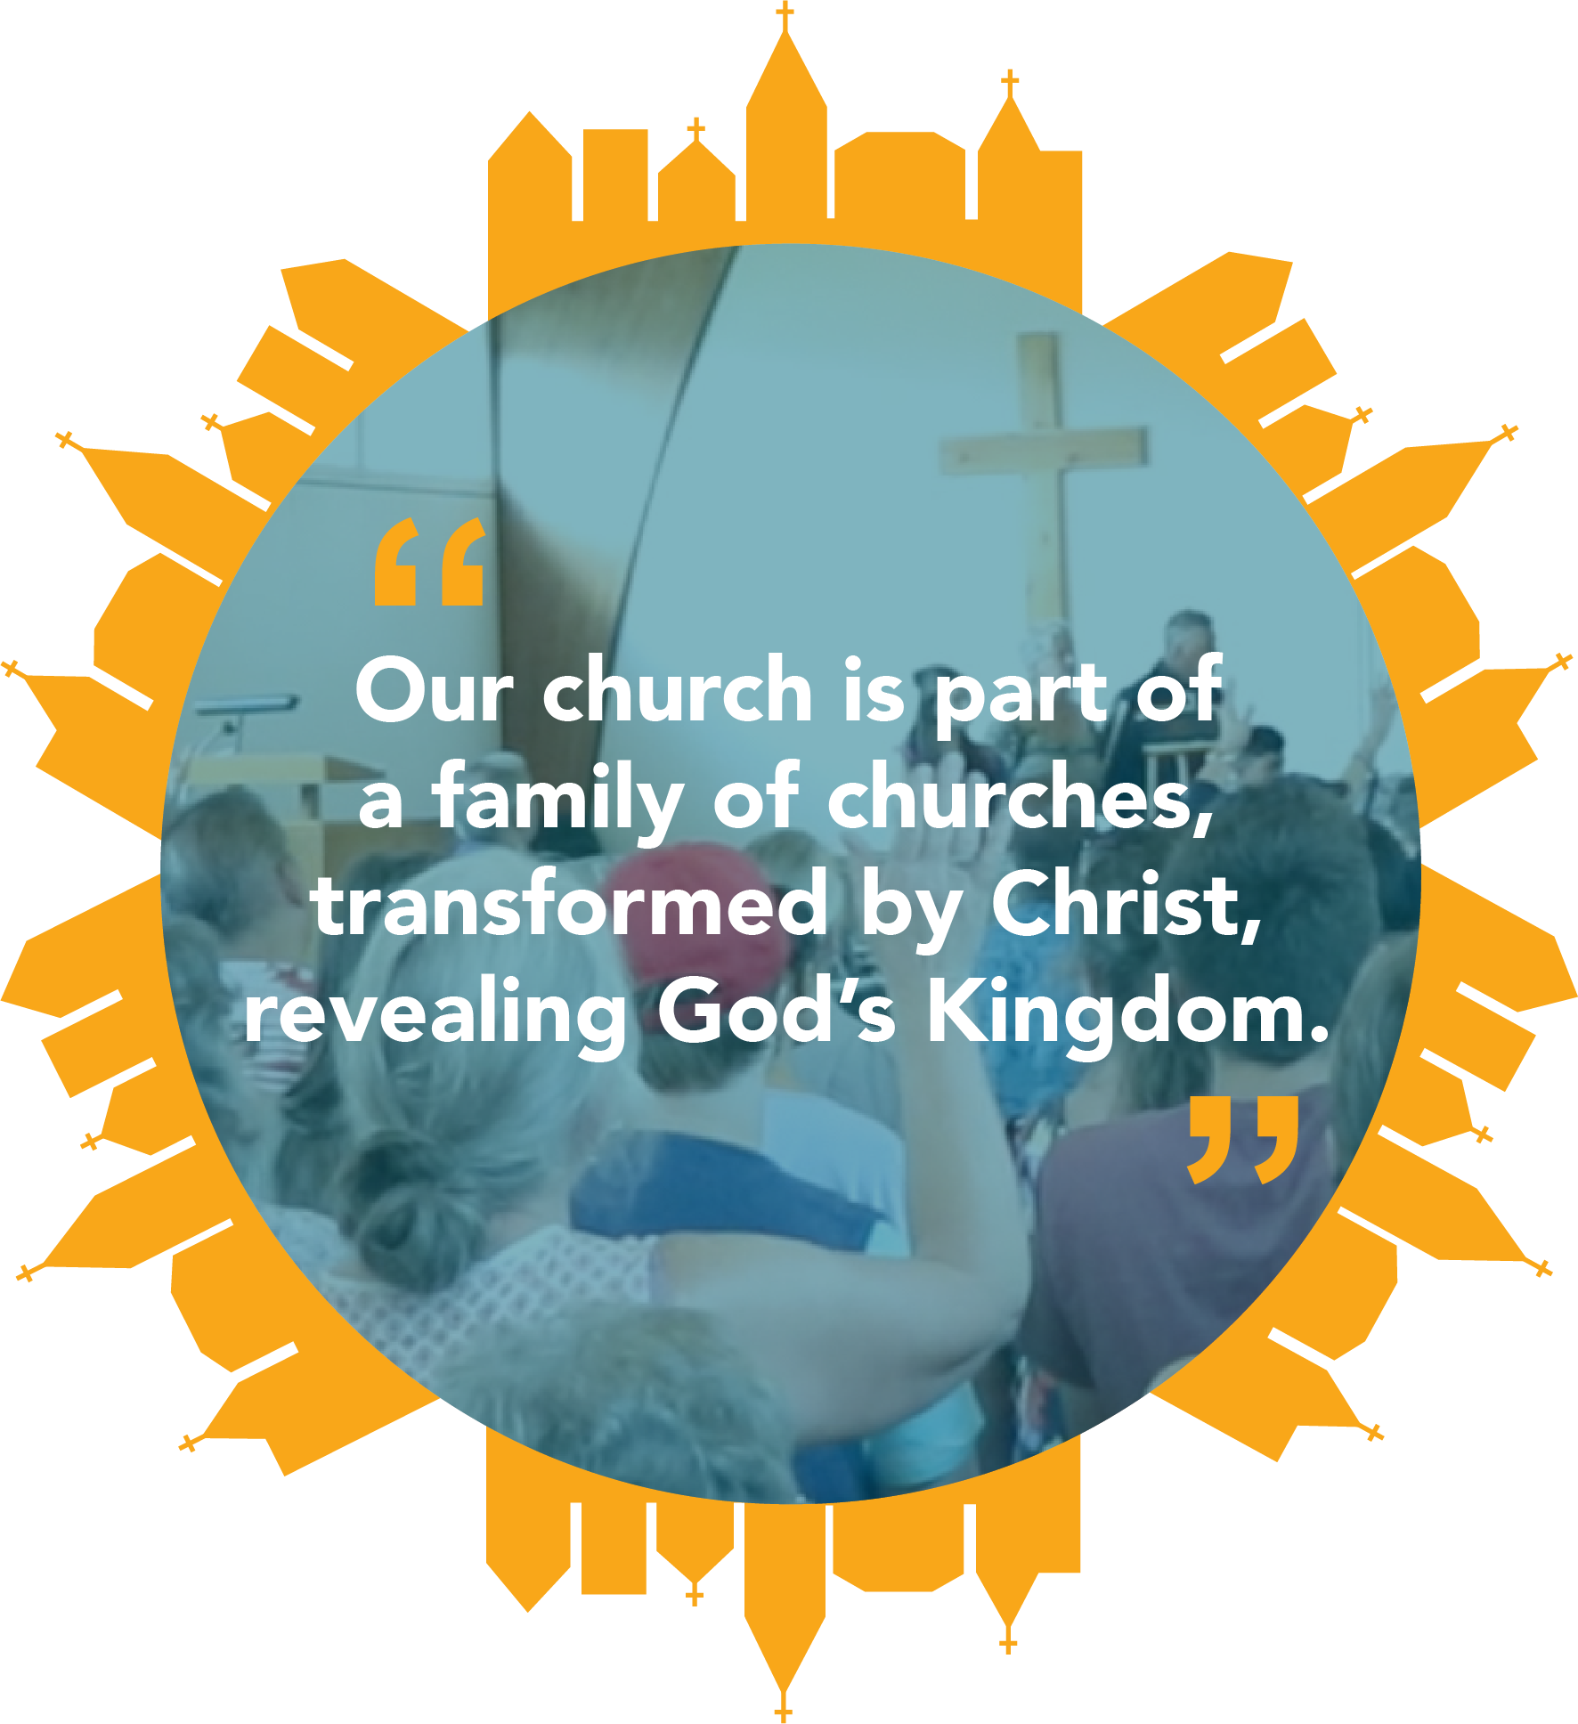

Slide 3
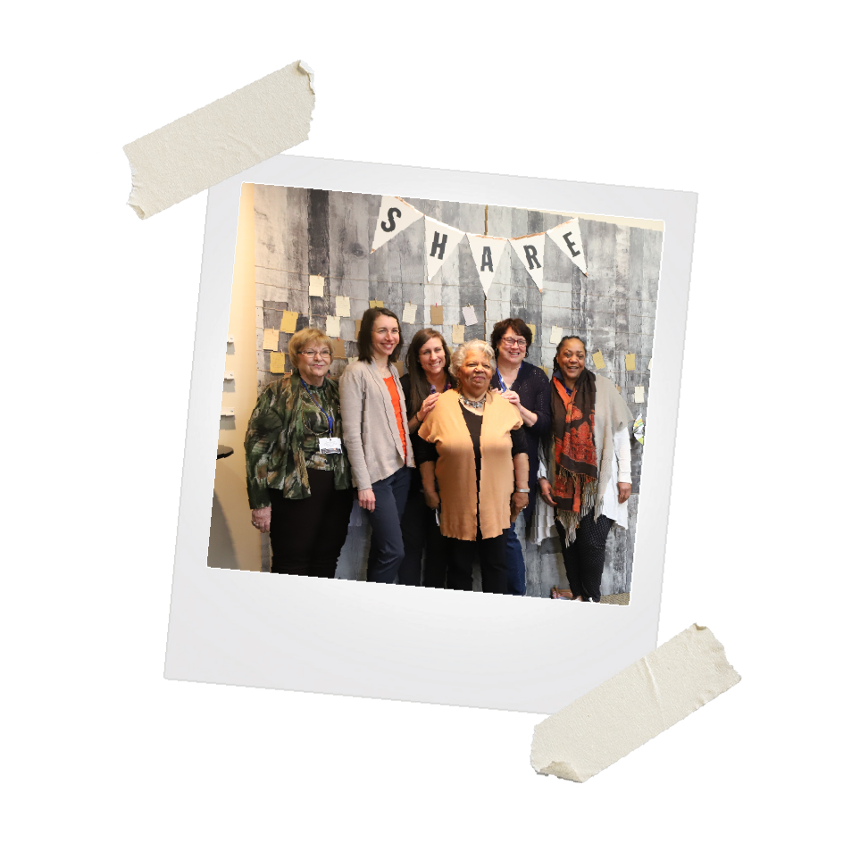
Each year, on a Sunday
in October, we celebrate
that we are part of this incredible CBOQ family.

Slide 4



Slide 5
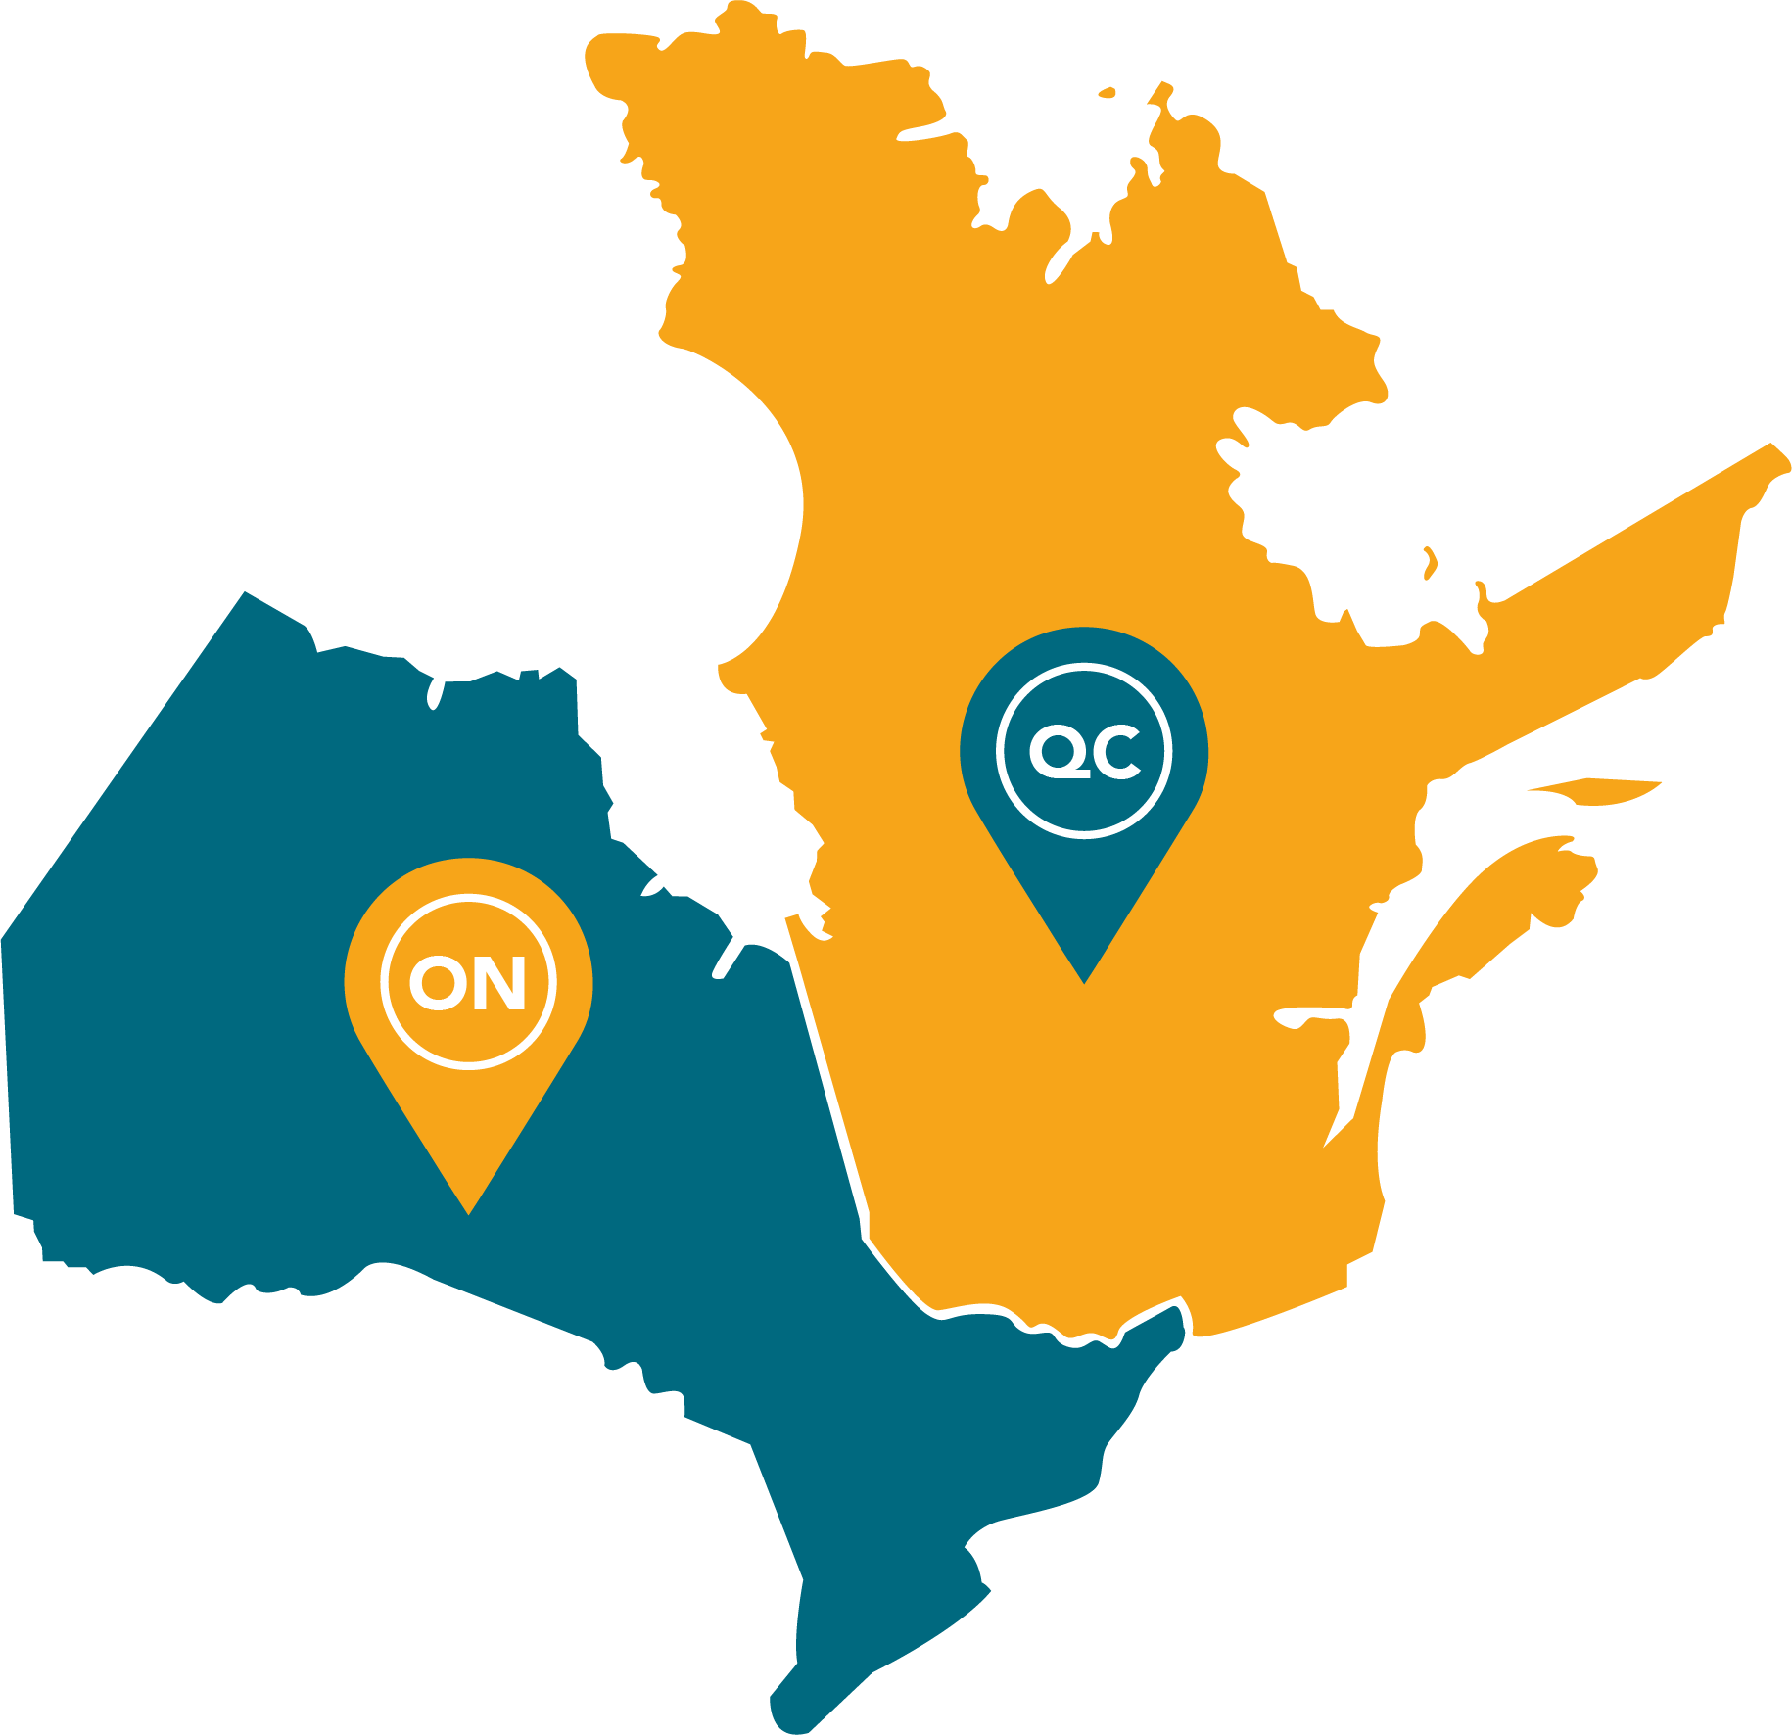
Across Ontario and Quebec, God’s kingdom is being revealed in our communities through our churches.

Slide 6
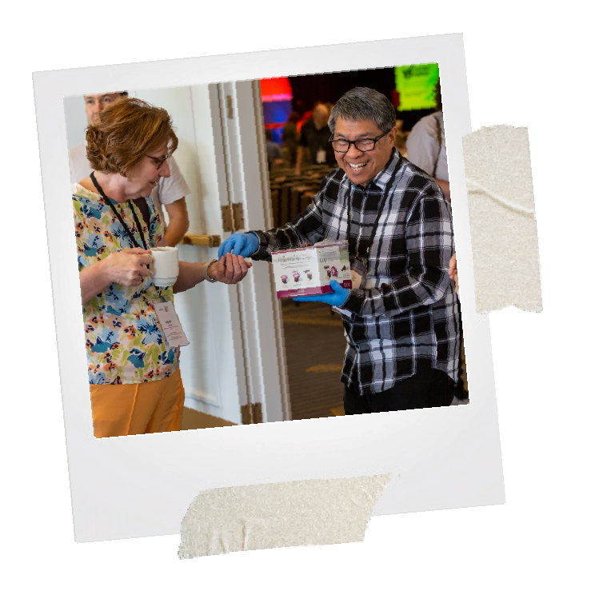
Through this partnership between our church and over 300 member churches, we are able to accomplish more together. In 2022, CBOQ gave back $808,000
in church grants, partner support
and pastor benefits and subsidies.
This represents 75% of the $1.08M entrusted to CBOQ by churches.

Slide 7
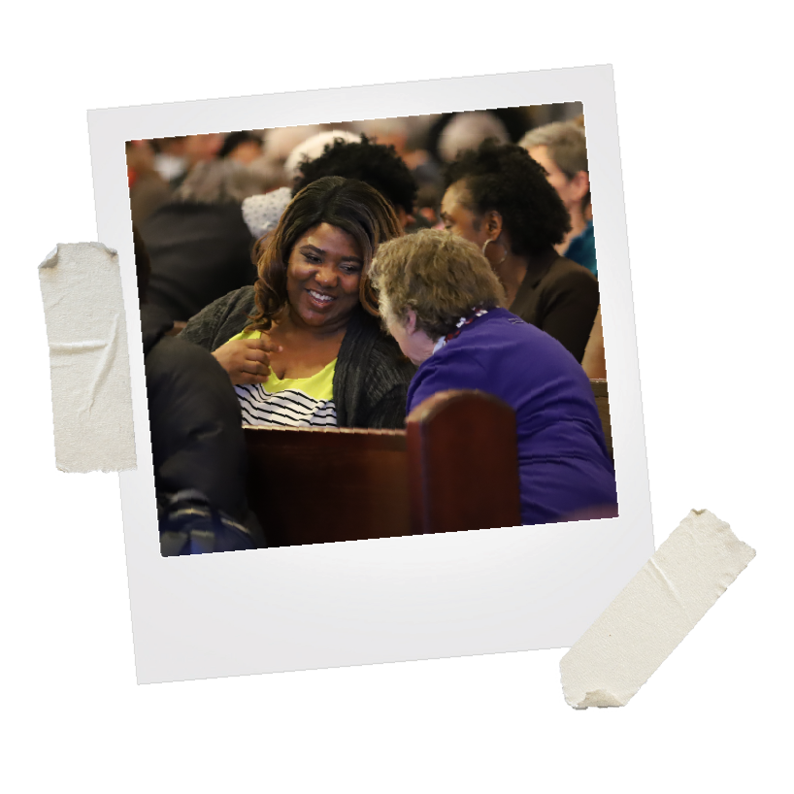

Sisters churches
partner to pray for each other throughout the year.

Slide 8
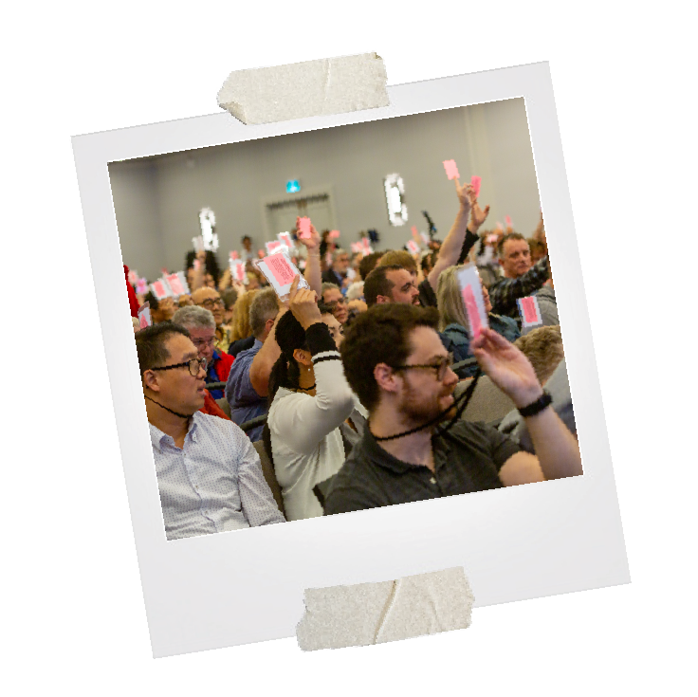
At our CBOQ Assembly annual gathering, we learn, worship,
and make decisions that will carve our path forward, together under the banner of Jesus.

Slide 9
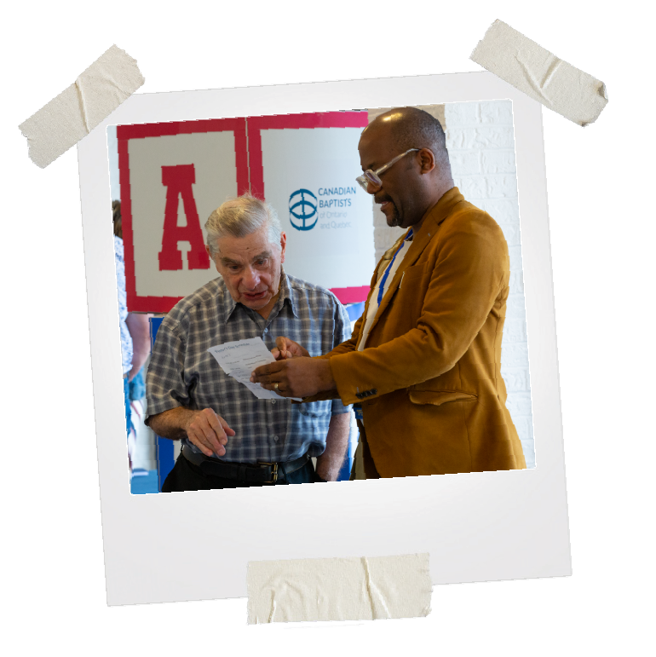
CBOQ staff serve and equip churches, pastors and leaders with resources, training, grants, and consultations.

Slide 10
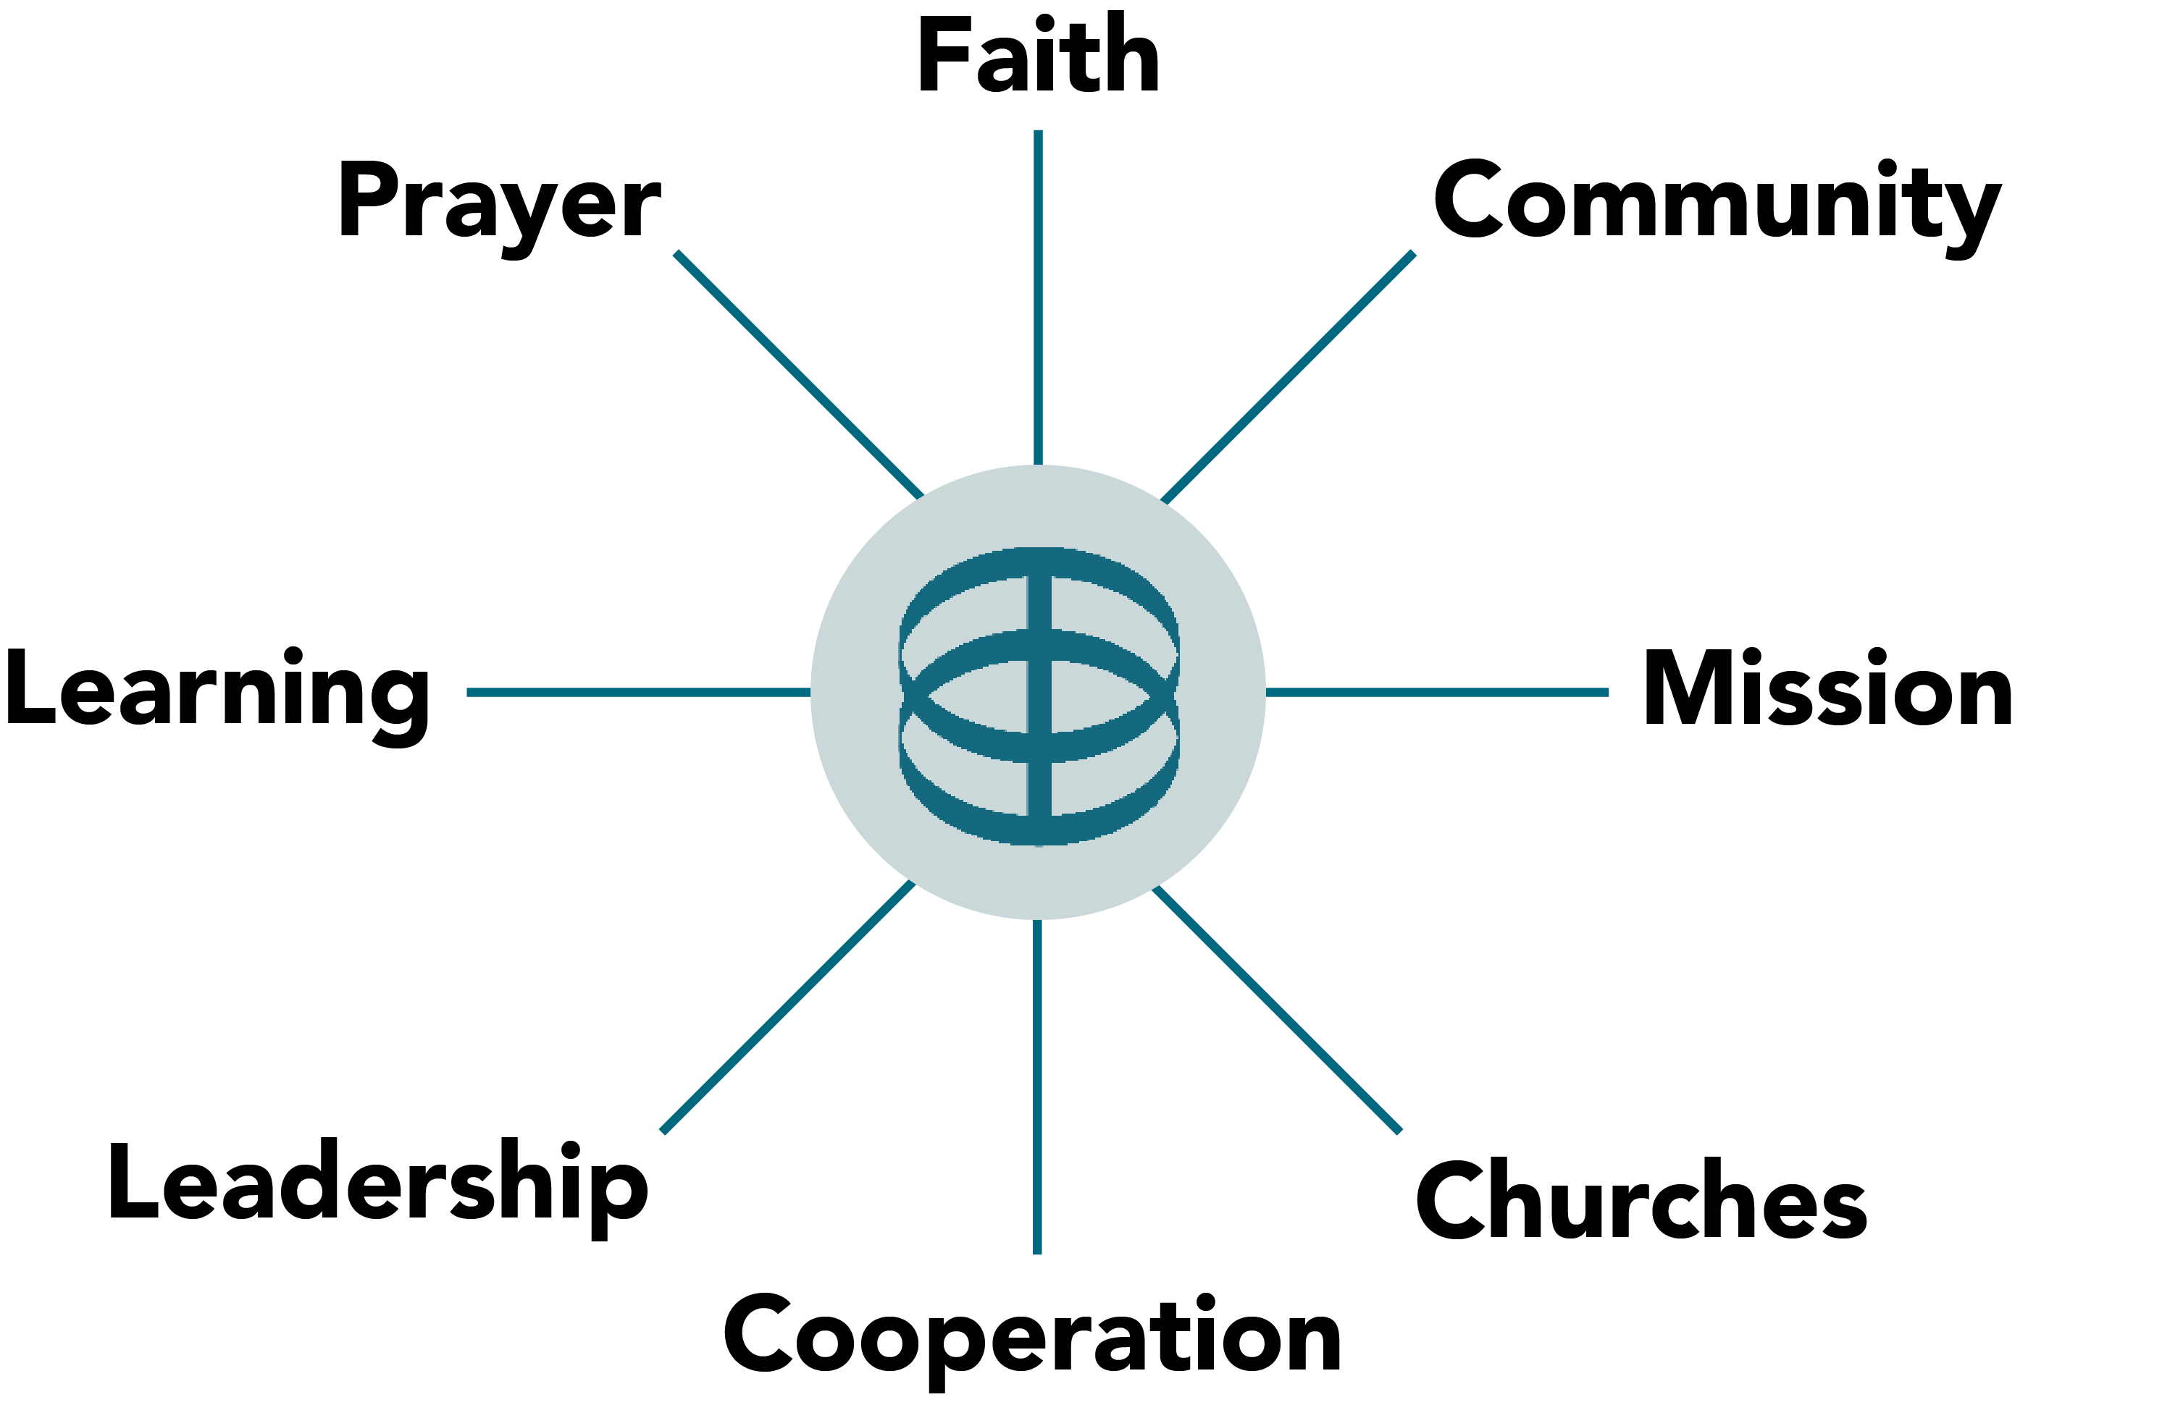
CBOQ
Core Values

Slide 11
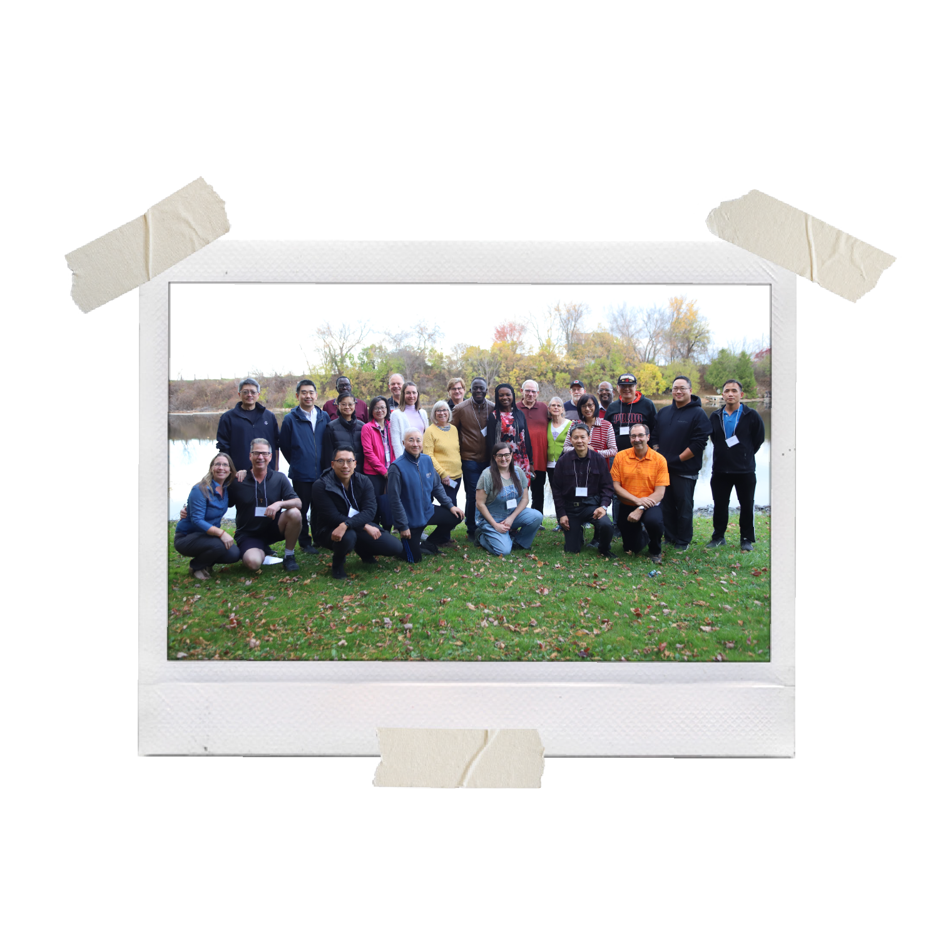
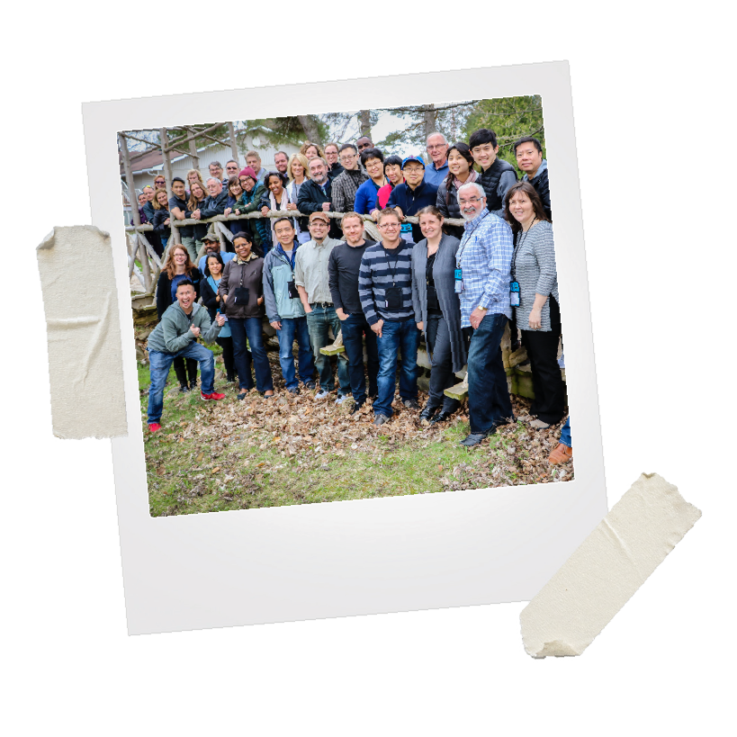
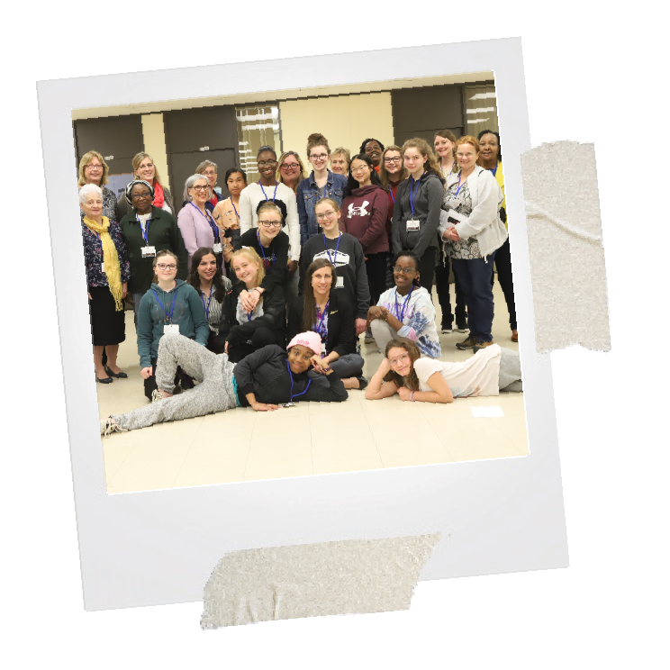
We are united by our common love of Jesus and God’s Word.
We seek to share the good news of Jesus with our neighbours
and share the love he has shown for us.
We rejoice in the gift of kingdom partnership that God
has given to us as part of the CBOQ family!

